Slide 1
Mid Semester Presentation
Digital Design of a Synthetic Ramp & Patterns Generation Unit for High-Speed Communication CMOS-Image-Sensor Applications
Students: Oded Sabari and Margarita Kouzmine
Supervisor: Vered Antebi

Slide 2
Table of contents
1
Background
Project definition and goals
Alternative solution 1
Alternative solution 2
Architectural design of the selected solution
Status and schedule for the remaining part
2
3
4
5
6

Slide 3
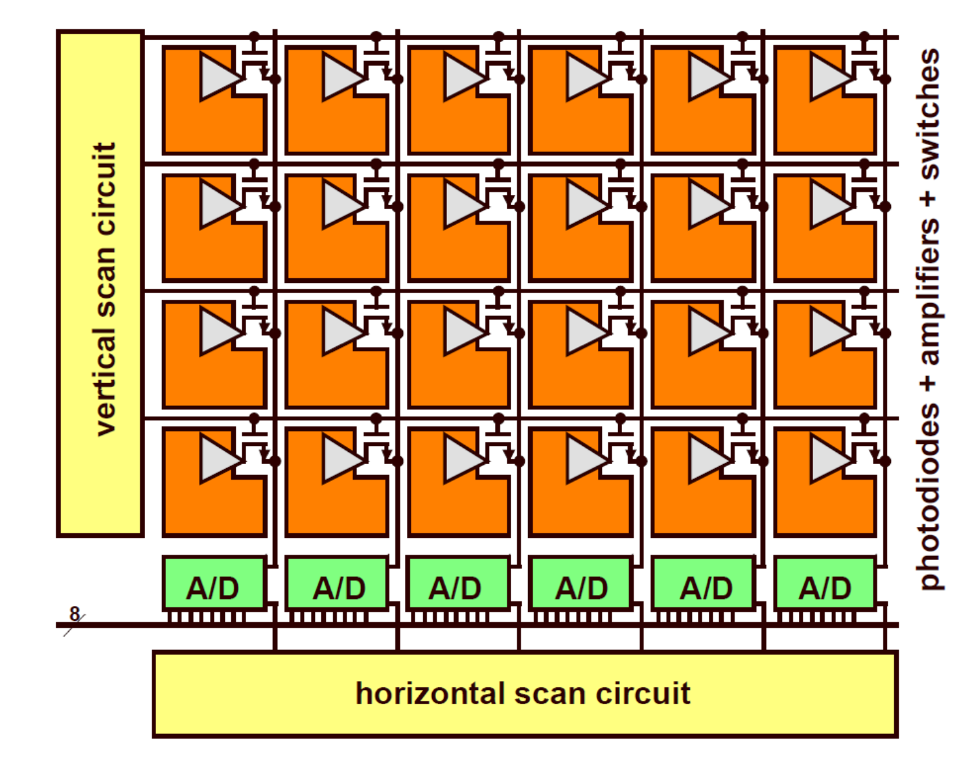
Background
Tower Semiconductors manufactures CMOS image sensors that capture light using an array of pixels. The light intensity at each pixel is converted from an analog voltage to a 12-bit digital signal through an analog-to-digital converter and is then organized into frames. The goal of this project is to design the digital component of the camera's analog-to-digital converter.

Slide 4
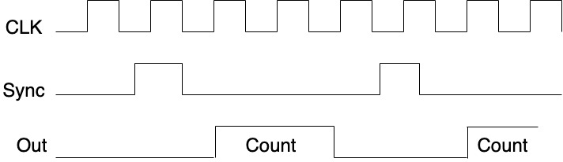
Project definition and goals
The digital part of the A/D converter has two modes of operation:
1.Regular mode, when the module receives the first sync signal, it begins counting in Gray code to minimize errors. The count restarts with each subsequent sync signal and continues until the 24th sync signal, indicating the end of the frame.

Slide 5
Project definition and goals
2.Test mode, the unit bypasses the pixel array and generates synthetic configurable values as outputs. The camera output includes:
A constant value provided by the user.
A checkerboard pattern, configurable as a 1x1 or 2x2 grid, with either a white or black start.
A matrix pattern with column increments of 0, 1, 4, or 8 and row increments of 0, 1, 16, or 1290.
In regular mode the count has 4096 values and in test mode the count has 1290 values.
The project aims to deliver optimal real-time performance while minimizing power consumption and area.

Slide 6
Alternative solution 1
Initial approach:
We implemented independent modules for each work and test mode, with the control block determining which module to use.
Problems with the solution:
Significant duplication, as each module required identical components, such as individual counters. This resulted in unnecessary waste and complexity, causing inefficiency and redundancy.

Slide 7
Rst
Clk
Gray
Counter
[11:0]val
00
Sync
Clk
Constant
f_Sync
Rst
clk
Control
rst
[2:0]Tsig
Mux
[0:11]Cnt
[2:0]Mode
Rst
Checkerboard
Clk
11
Sel
[1:0]x
Extracting
ramp
[1:0]y
clk
[1:0]OutSel

Slide 8
Alternative solution 2
Second approach:
We replaced duplicate components with global ones, such as global counters. Specifically, we used three counters: one to track when a count ends, another to signal the end of a frame, and a third to manage the output. Additionally, we created a module called FirstVal to calculate the initial value for each line.
Problems with the solution:
First, we still had unnecessary actions, such as the calculation of the initial value in all working modes. Additionally, all components were active all the time, leading to significant power consumption.

Slide 9
reset
test
clk
12bit
Counter
NewLine
EndLine
reset
EndFrame
5bit
Counter
reset
clk
clk
NewLine
Binary_or_Gray
Sync
f_Sync
[2:0]mode
Control
[1:0]X
[2:0]Xmode
Binary2Gray
[1:0]Y
reset
[11:0]val
clk
mux
[0:11]Cnt
Counter
[11:0]s_Val
Update
NewLine
Load
[1:0]Ymode
[11:0]LoadVal
reset
FirstVal
clk

Slide 10
Architectural design of the selected solution
The final solution:
We replaced the FirstVal module with a simpler module that calculates the initial value of each row only when needed. This module is connected to a multiplexer that supplies the counter with various inputs based on the work mode.
We also added enable inputs to various blocks to conserve power when they are not in use.
Additionally, this new approach allowed us to reduce the size of our state machine, enhancing overall efficiency.

Slide 11
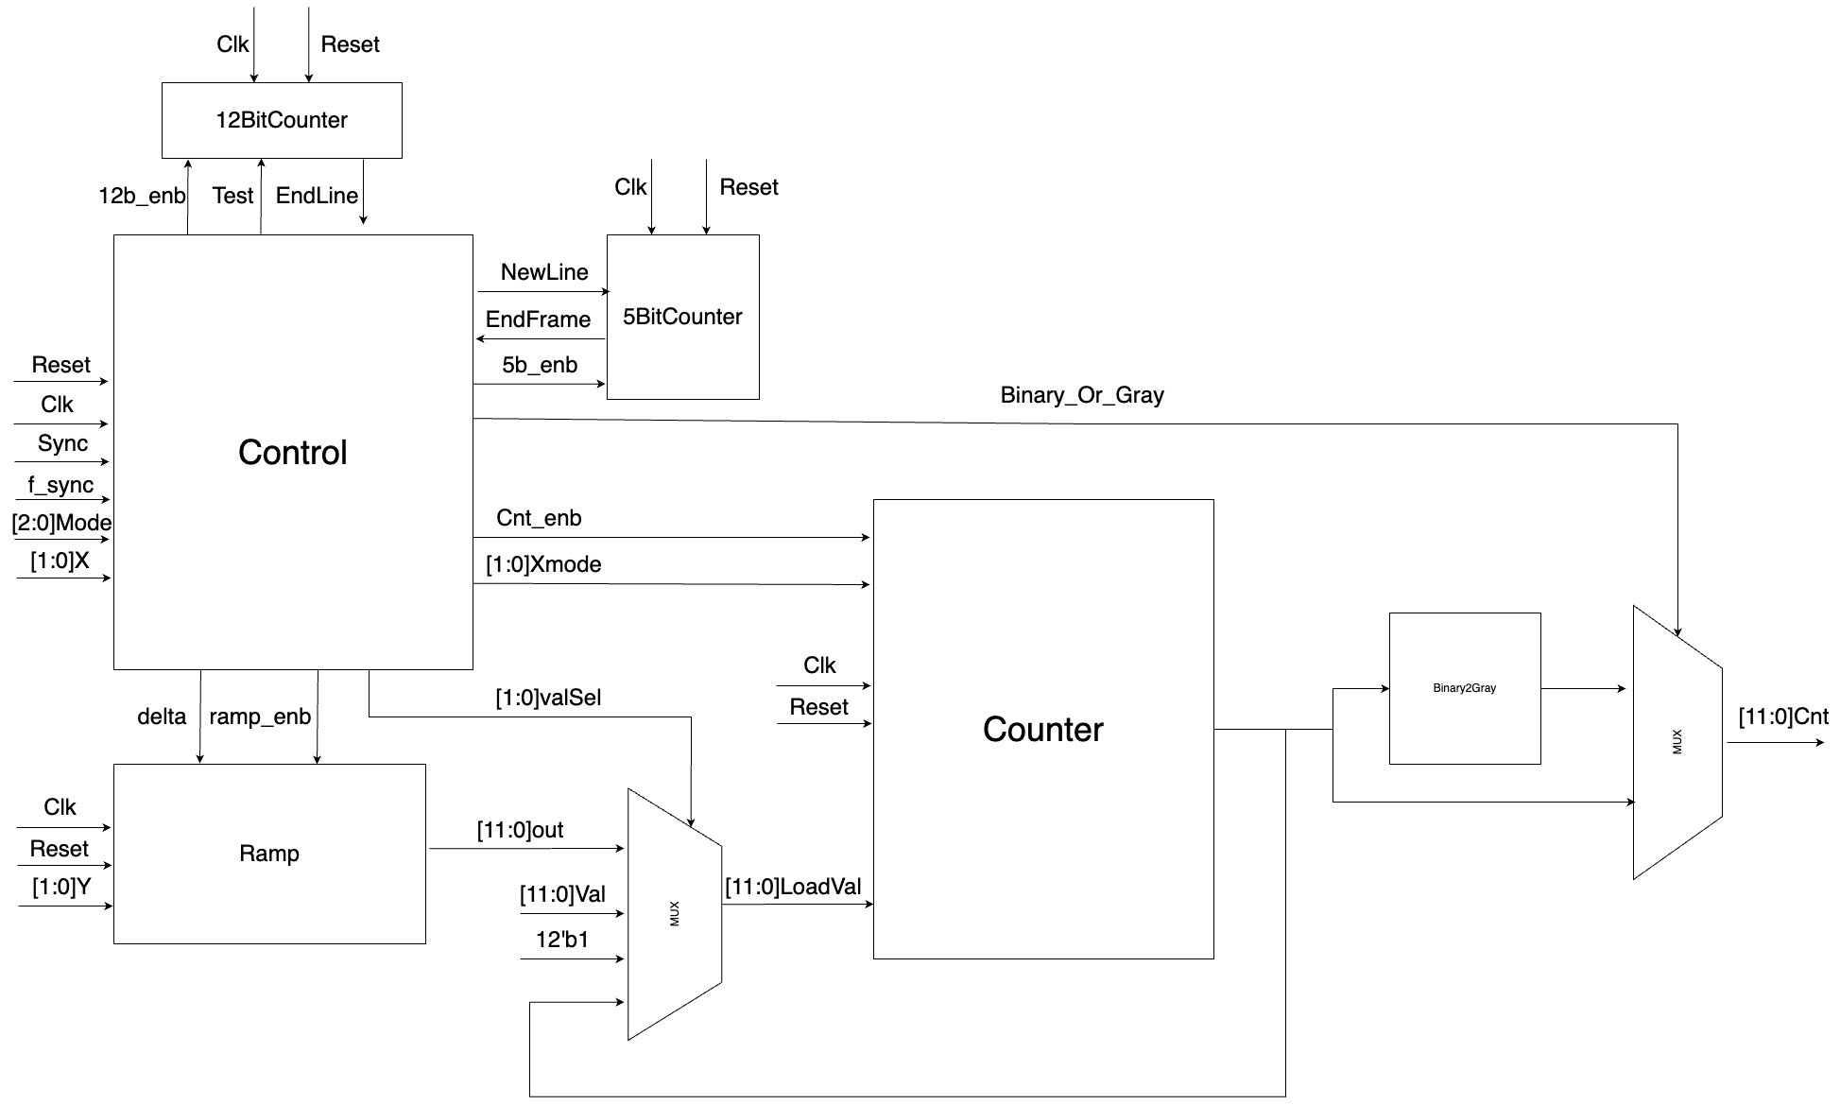

Slide 12
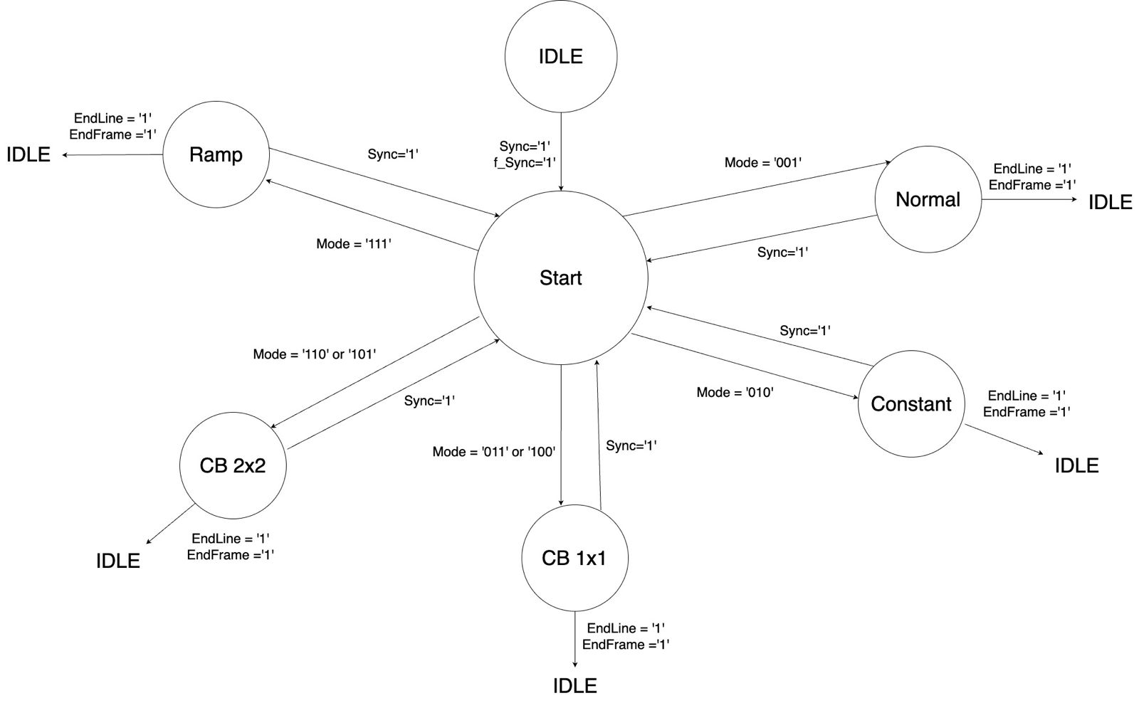

Slide 13
Status and schedule for the remaining part
The following stages have been completed:
Architectural and Logic Design
HDL Implementation using Verilog
The remaining tasks are:
Verification (to be completed by the last week of August)
Synthesis (to be completed by the last week of September)
Layout Design (to be completed by the first week of October)
Final Report (to be completed by the third week of October)

